Slide 1

校園故事 (Animaze) 110590033 陳庠蓁
Notes:
https://unsplash.com/photos/silhouette-of-people-standing-on-hill-pYWuOMhtc6k

Slide 2
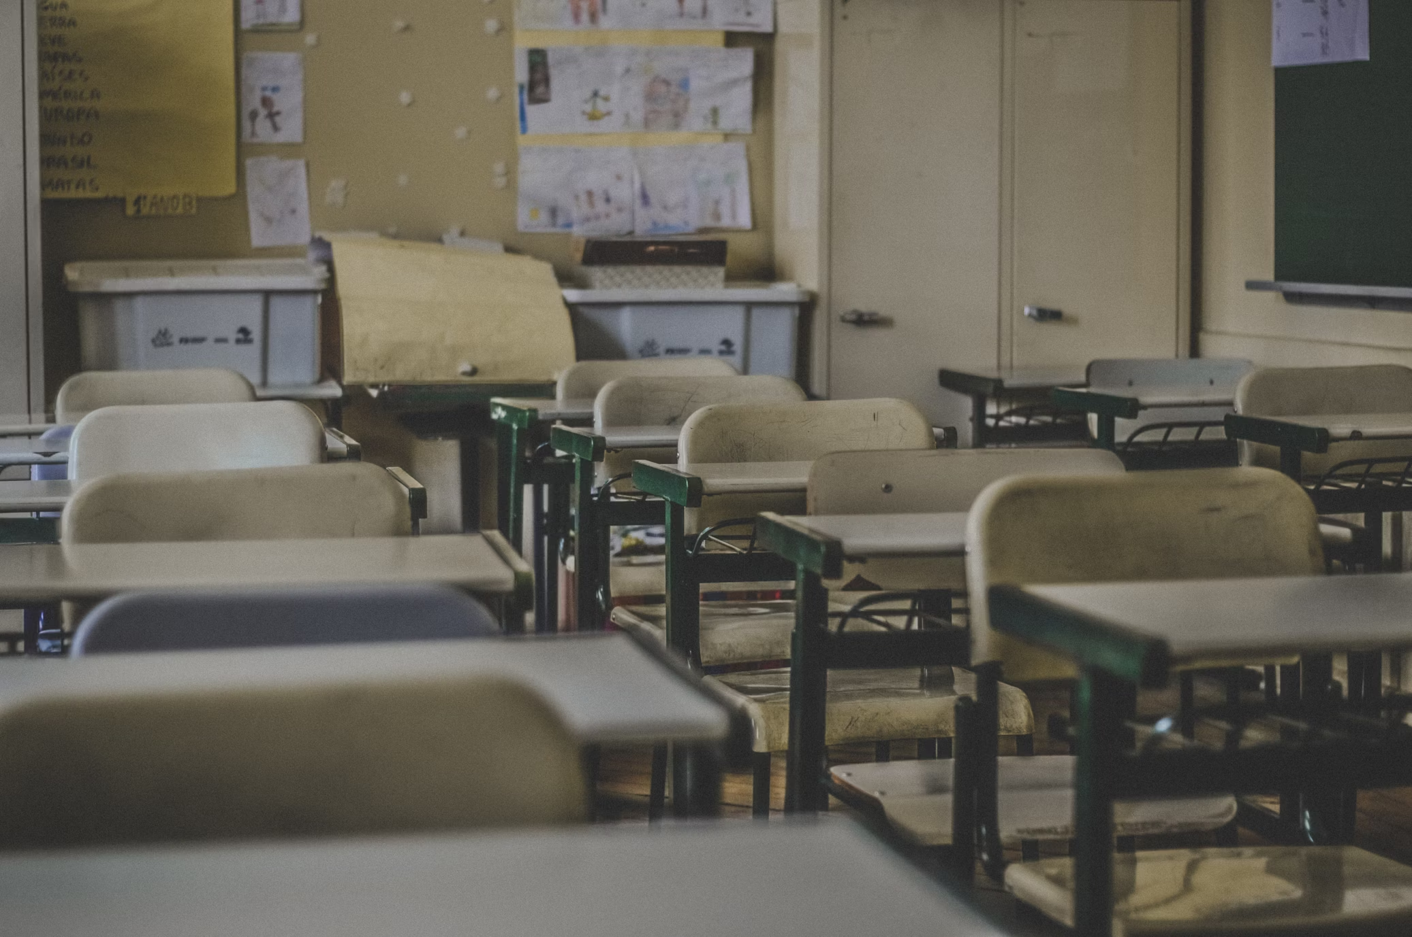
Notes:
https://unsplash.com/photos/photography-of-school-room-hes6nUC1MVc

Slide 3

1. 目標
Notes:
https://unsplash.com/photos/several-unsuccessful-attempts-at-a-red-arrow-that-missed-the-target-on-a-light-red-background-failure-in-attempts-to-achieve-goals-3d-render-illustration-pz_2DFD9ywY

Slide 4

Notes:
https://unsplash.com/photos/teamwork-word-on-business-working-table-business-teamwork-concept-2z95Nue9QNs

Slide 5
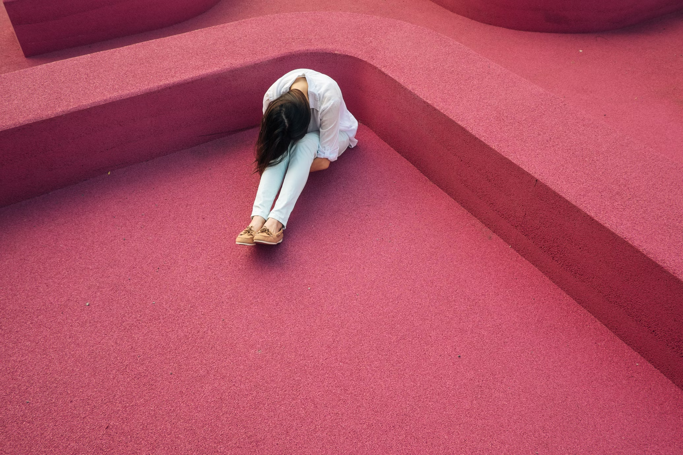
2. 阻礙
Notes:
https://unsplash.com/photos/woman-sitting-leaning-forehead-on-knee-VIO0tyzXL4U

Slide 6
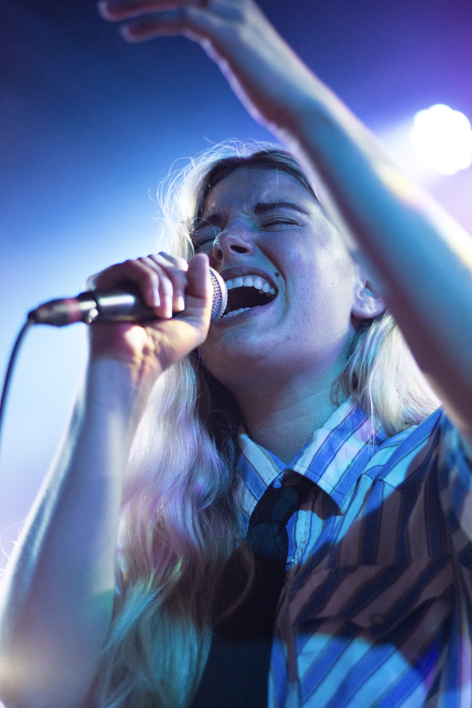
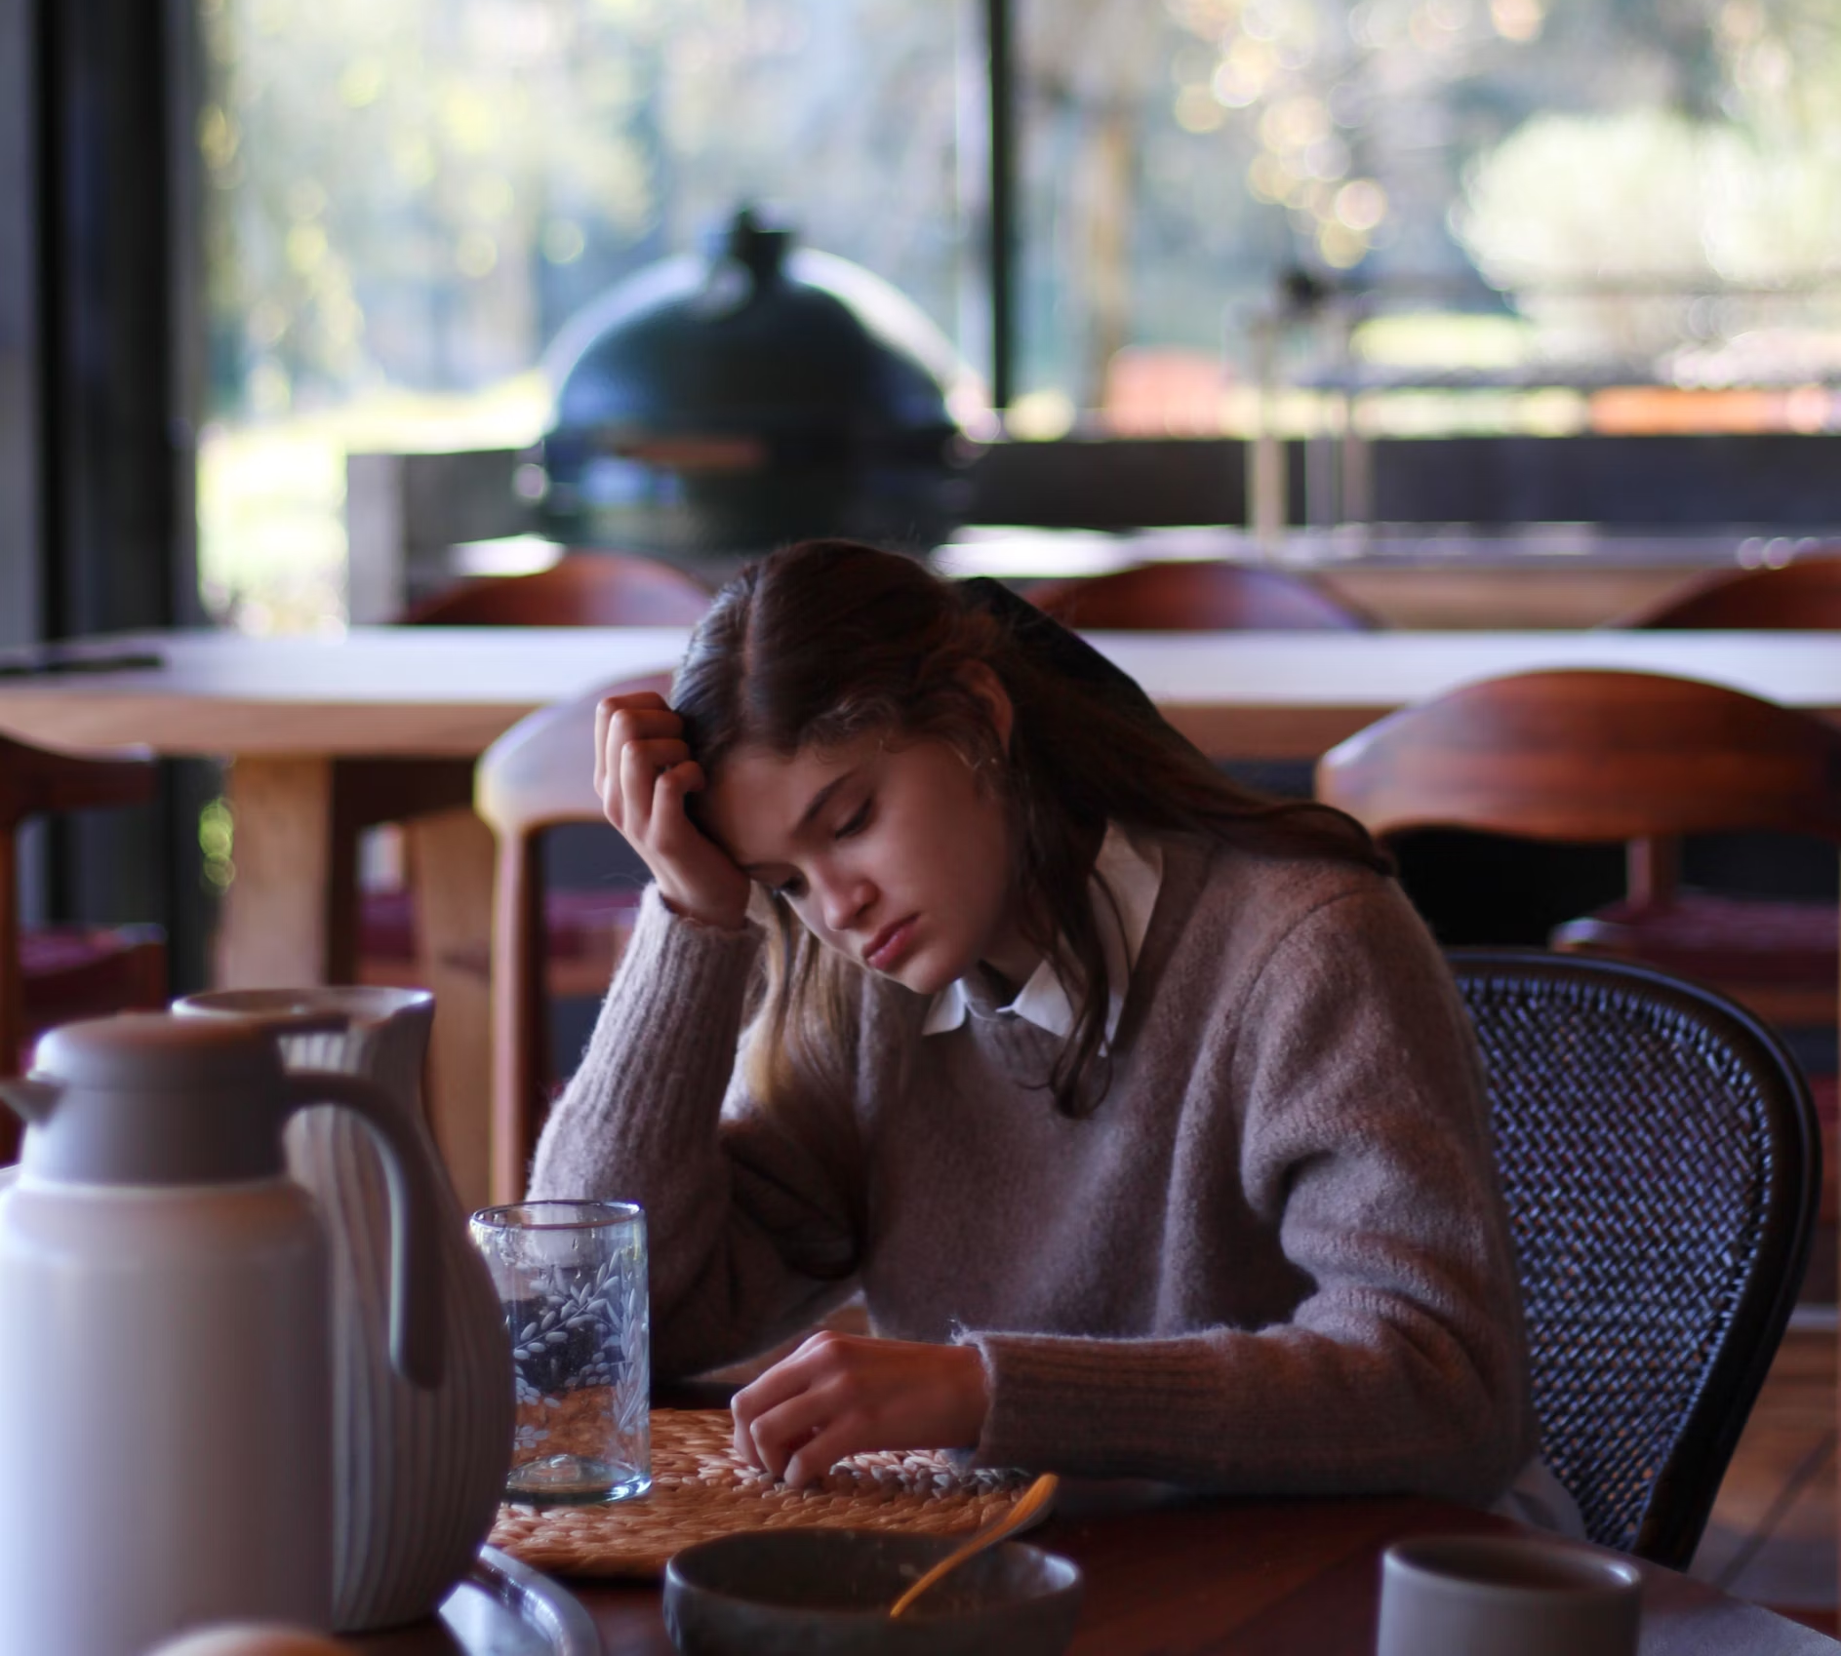
Notes:
https://unsplash.com/photos/woman-singing--Gx7tuwO8_U https://unsplash.com/photos/woman-in-gray-long-sleeve-shirt-sitting-on-brown-wooden-chair-9USYbfMD250

Slide 7

3. 努力
Notes:
https://unsplash.com/photos/a-neon-sign-that-says-dont-cut-on-a-brick-wall-zFHanBK18n4

Slide 8

Notes:
https://unsplash.com/photos/an-overhead-view-of-a-soccer-goal-on-a-soccer-field-QjnjCLTM4eU

Slide 9

Notes:
https://unsplash.com/photos/person-holding-clapperboard-Hn3S90f6aak

Slide 10

4. 結果
Notes:
https://unsplash.com/photos/selective-focus-photo-of-brown-and-blue-hourglass-on-stones-BXOXnQ26B7o

Slide 11
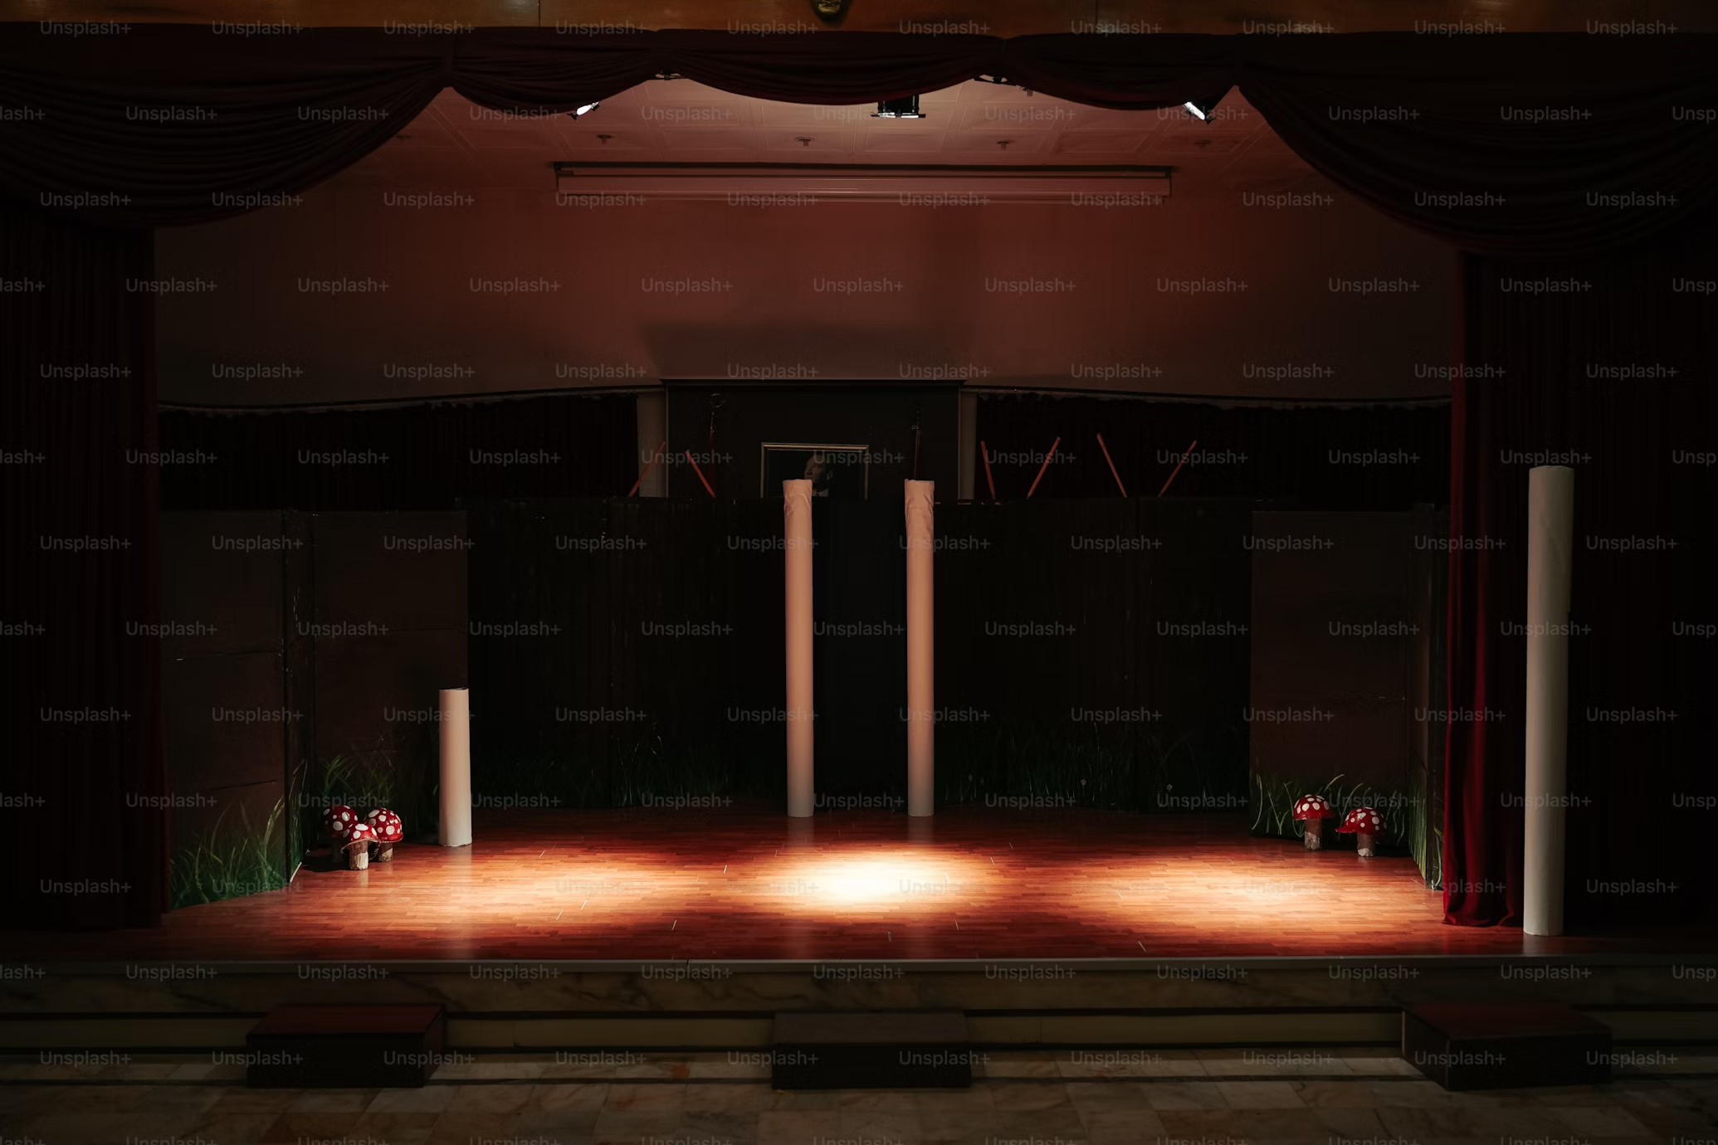
Notes:
https://unsplash.com/photos/a-stage-with-a-red-curtain-and-some-lights-J8vKNwOVGJ8

Slide 12

Notes:
https://unsplash.com/photos/businesswoman-proficiently-present-work-project-receive-celebrations-from-team-corporate-business-team-collaboration-concept-ALkUMC3O9nA

Slide 13

5. 意外
Notes:
https://unsplash.com/photos/an-ambulance-driving-down-a-street-next-to-a-building-EmXM5kcN3lw

Slide 14

Notes:
https://unsplash.com/photos/a-woman-laying-in-a-hospital-bed-with-an-iv-in-her-hand-GwgFPDXiSIs

Slide 15

6. 轉彎
Notes:
https://unsplash.com/photos/concept-art-of-way-road-hope-and-success-surreal-street-on-the-sea-mystery-landscape-conceptual-3d-illustration-painting-p0bD1QalfZ4

Slide 16

Notes:
https://unsplash.com/photos/photo-of-three-butterflies-pollinating-on-purple-petaled-flowers-Kol2ib6ehQE

Slide 17
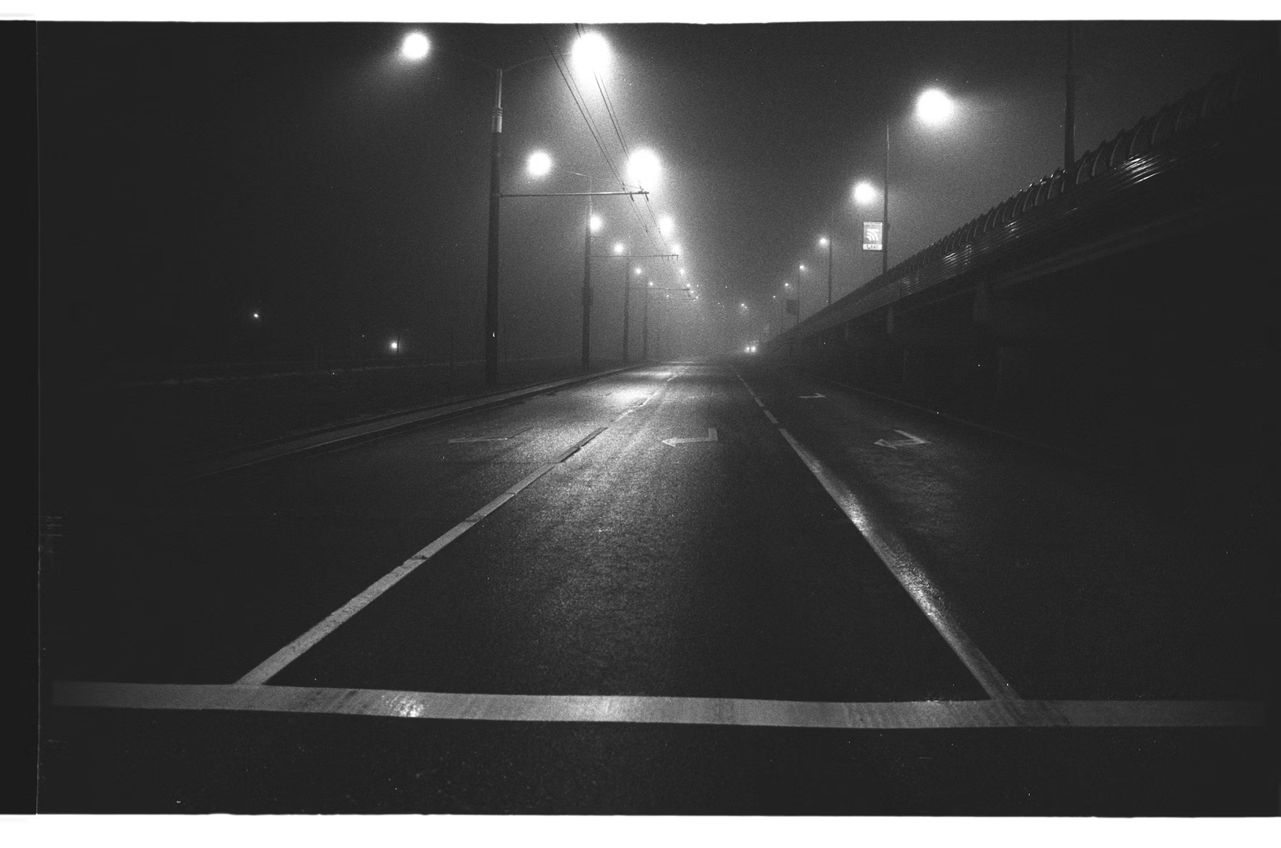
7. 結局
Notes:
https://unsplash.com/photos/road-and-lampposts-during-day-nah6xnY-IRA

Slide 18
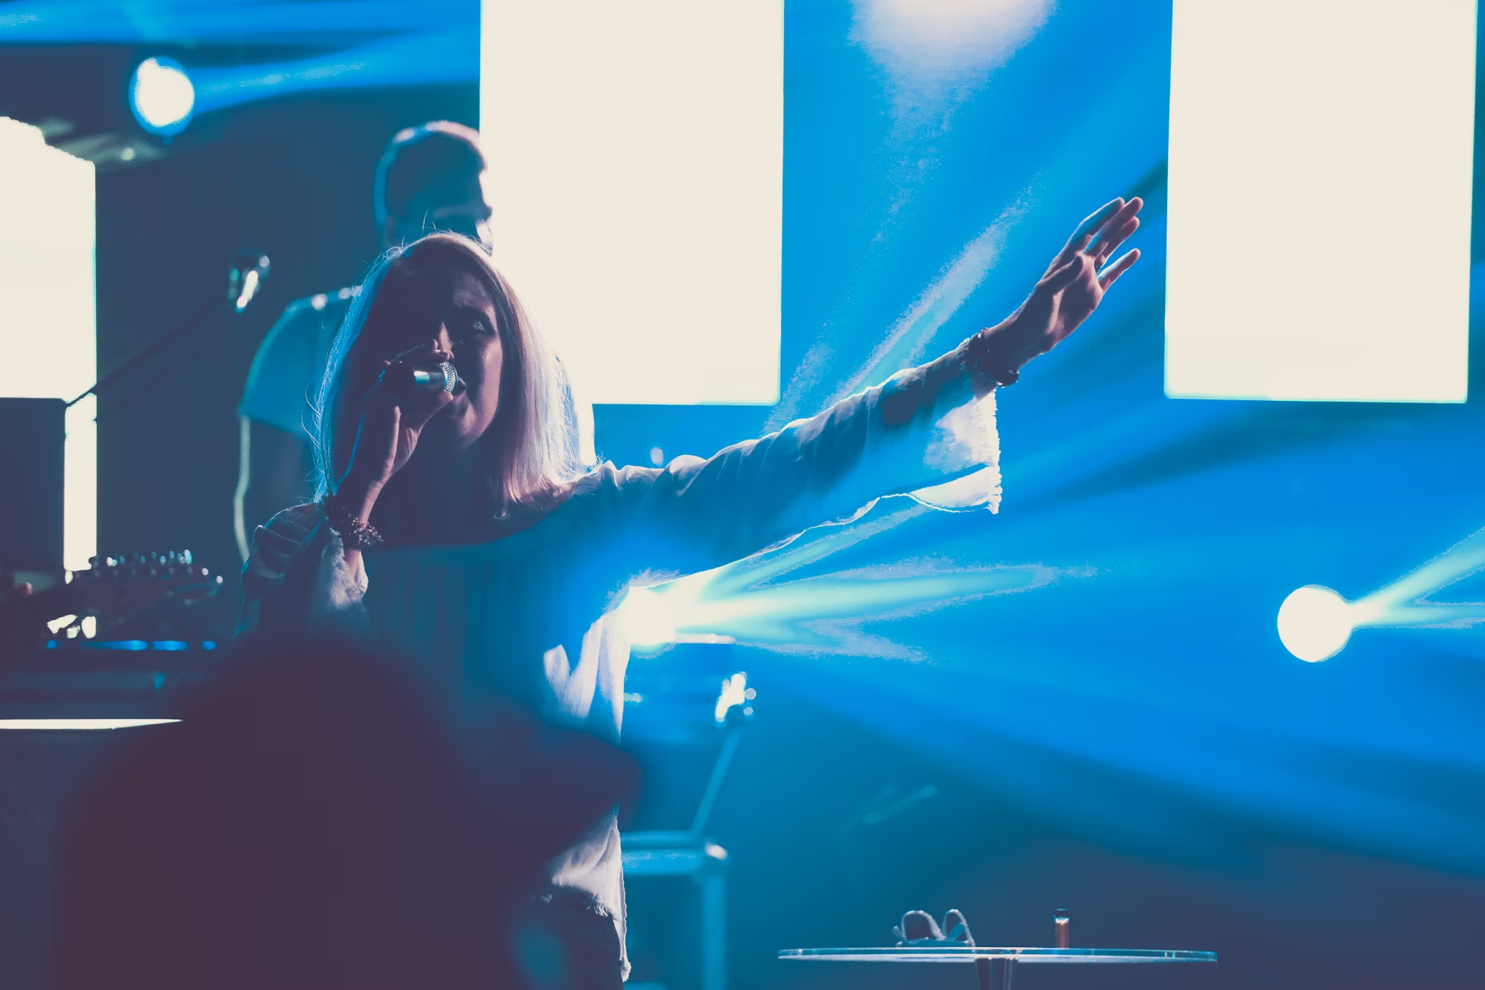
Notes:
https://unsplash.com/photos/woman-singing-at-stage-YirHYHAI2l4

Slide 19

Notes:
https://unsplash.com/photos/people-gathering-on-a-concert-during-night-time-TKcJXer_2fU

Slide 20

Notes:
https://unsplash.com/photos/man-on-grass-field-looking-at-sky-JrZ1yE1PjQ0

